Slide 3
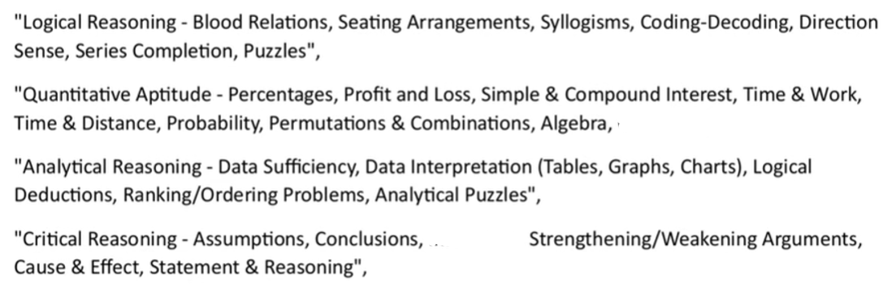

Slide 4
Statement: C < L < O = U = D > S > Y
Conclusion:
I. O > Y
II. C < D
Neither conclusion I nor II follows
Both conclusions I and II follows
Only conclusion I follows
Only conclusion II follows
Either conclusion I or II follows

Slide 5
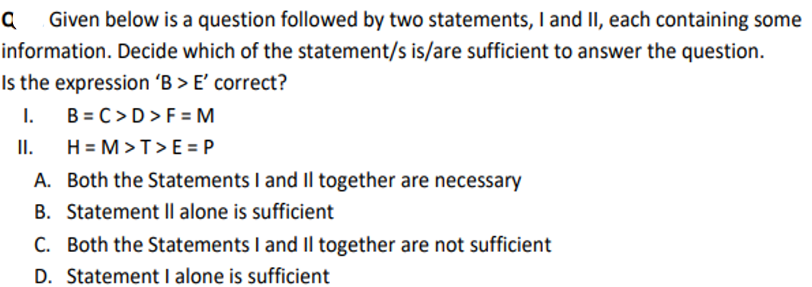

Slide 6
Statement: K > I > T > E; O < R < K
Conclusion:
I. R < E
II. O < T
Neither conclusion I nor II follows
Both conclusions I and II follows
Only conclusion II follows
Either conclusion I or II follows
Only conclusion I follows

Slide 7
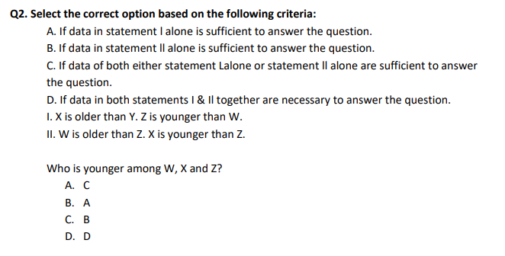

Slide 8
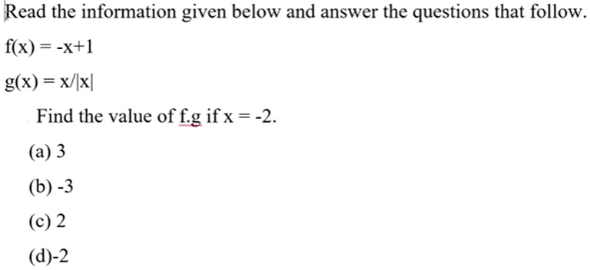

Slide 9
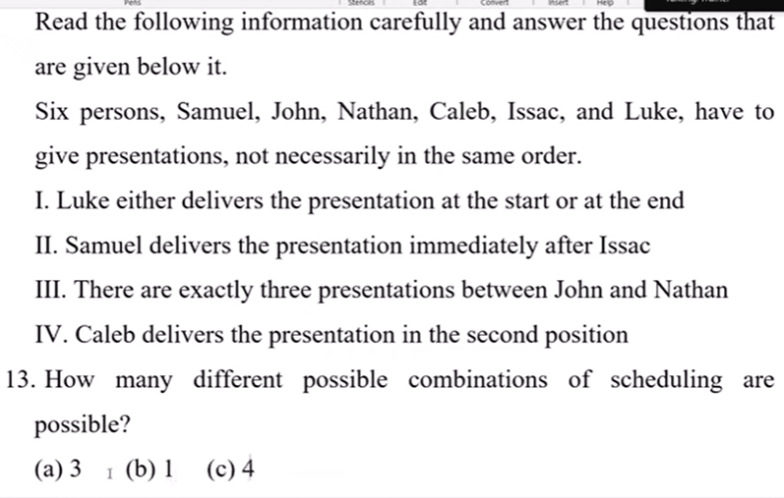

Slide 10
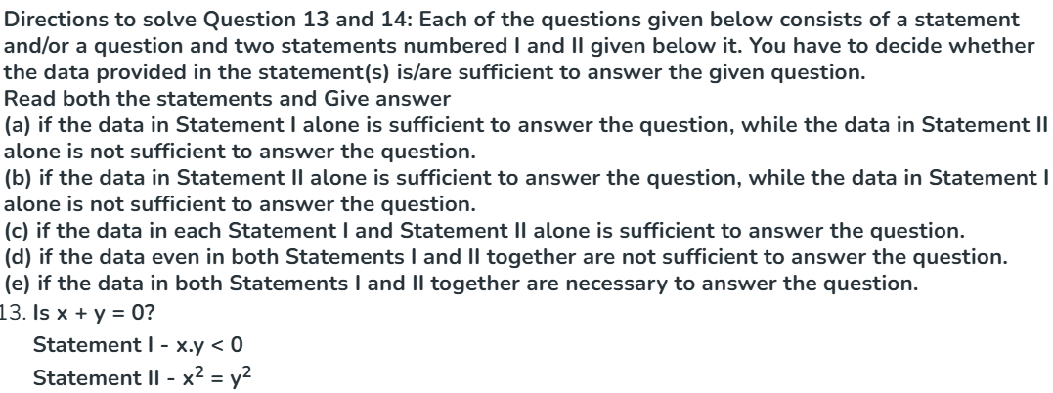

Slide 11
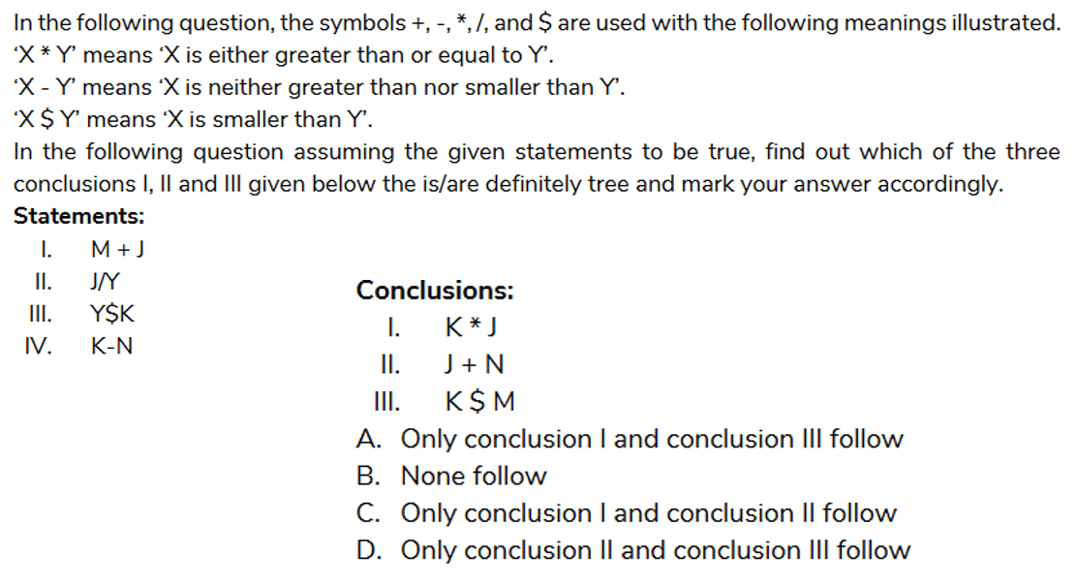

Slide 12
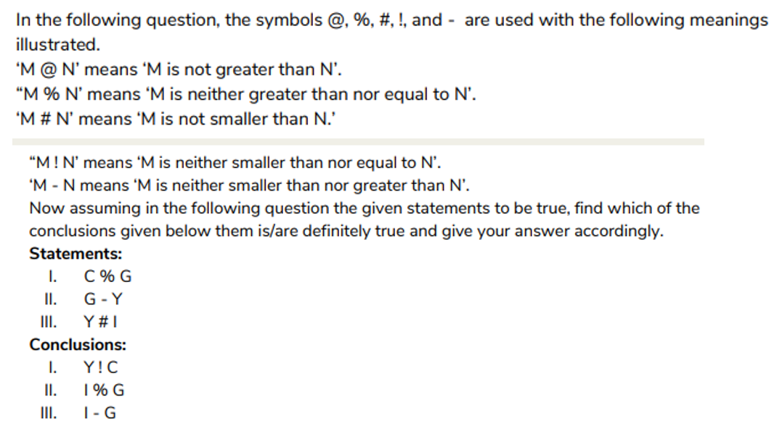

Slide 13
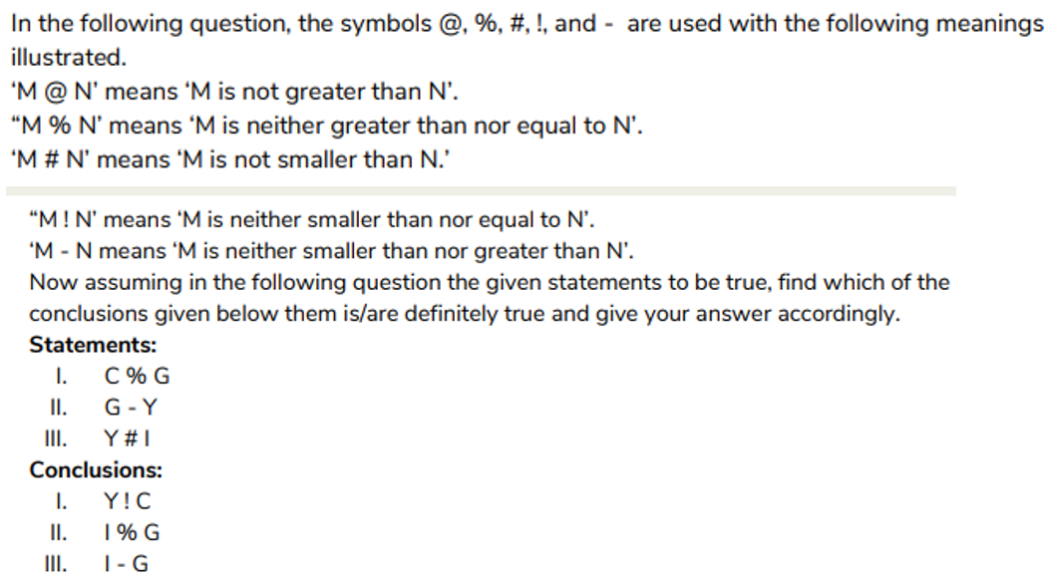

Slide 14


Slide 15
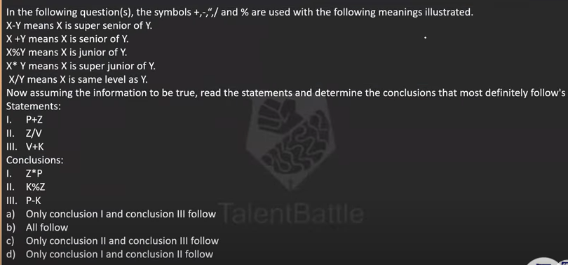

Slide 16
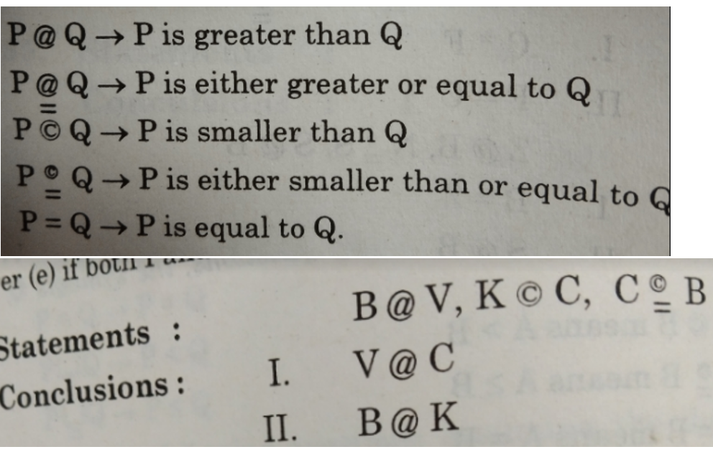

Slide 17
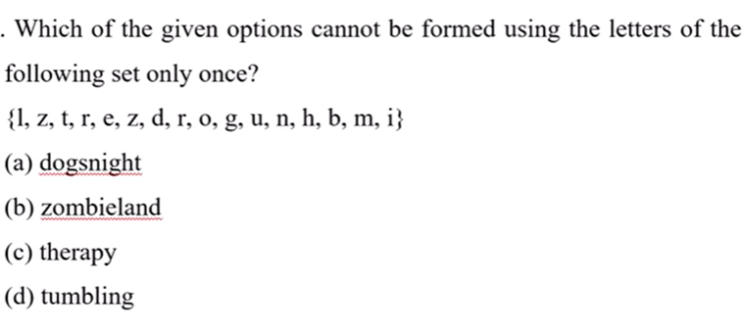

Slide 18
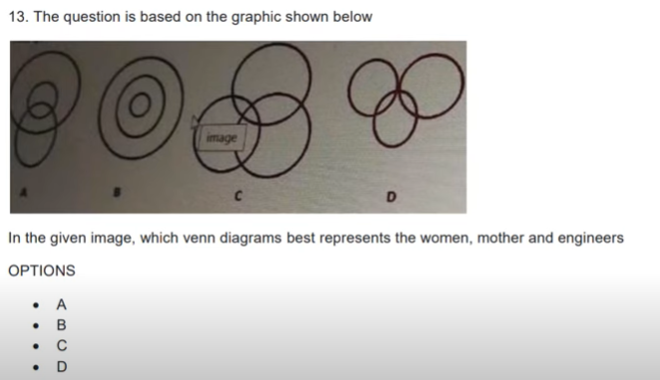

Slide 19
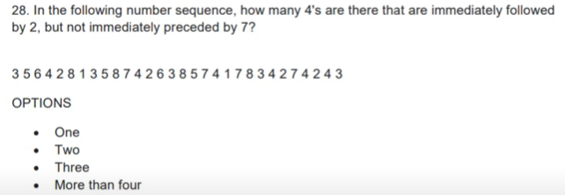

Slide 20
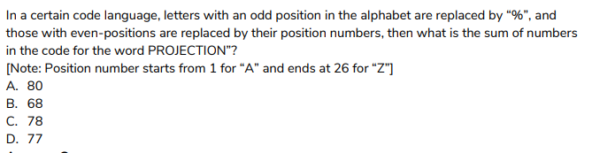
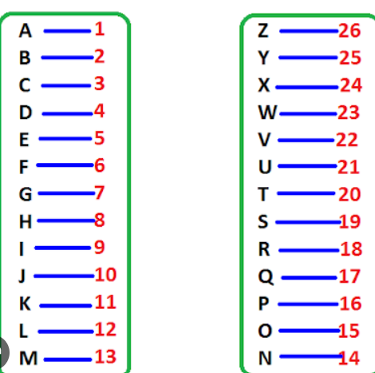

Slide 21
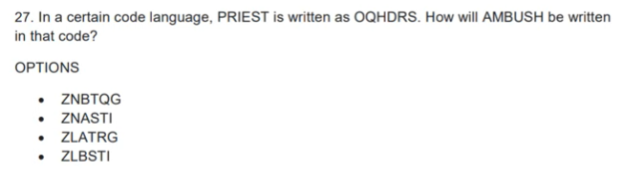

Slide 22
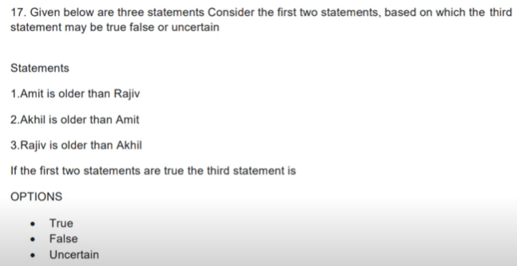

Slide 23
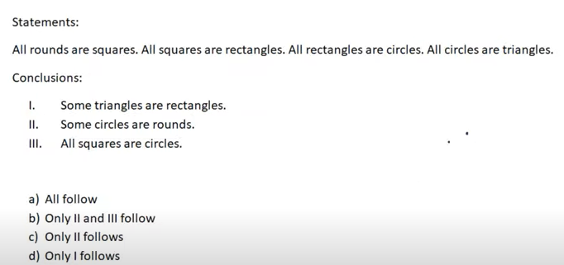

Slide 24
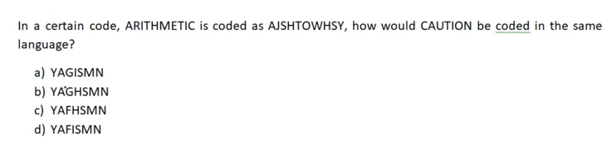

Slide 25
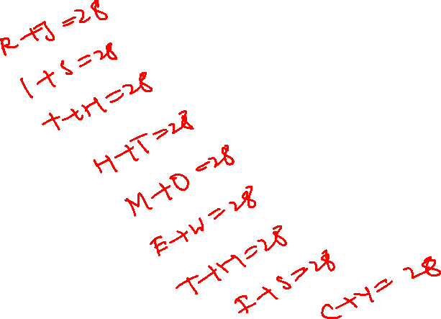

Slide 26
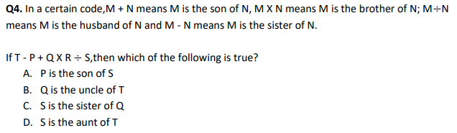

Slide 27
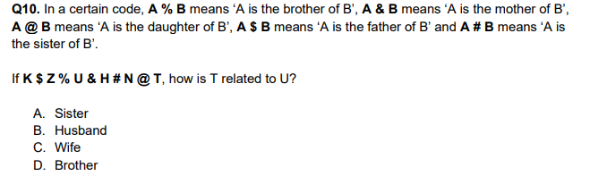

Slide 28
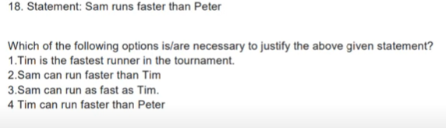

Slide 29
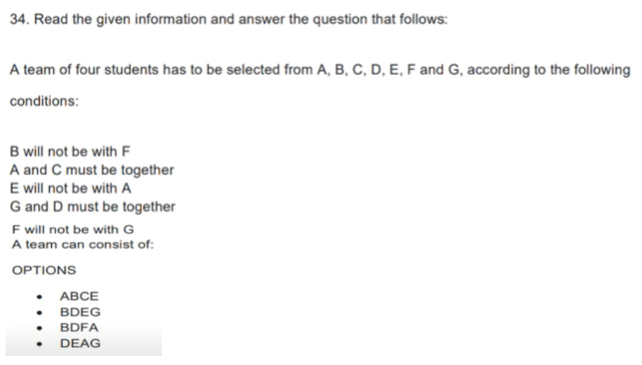

Slide 30
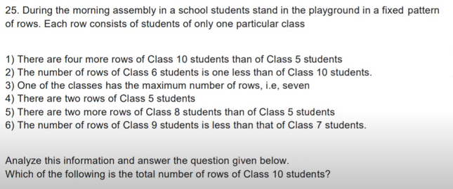

Slide 31
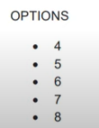

Slide 32
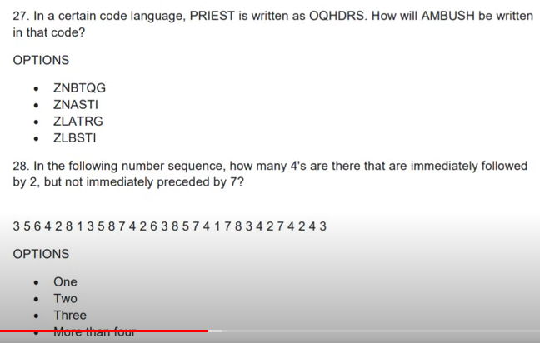

Slide 33
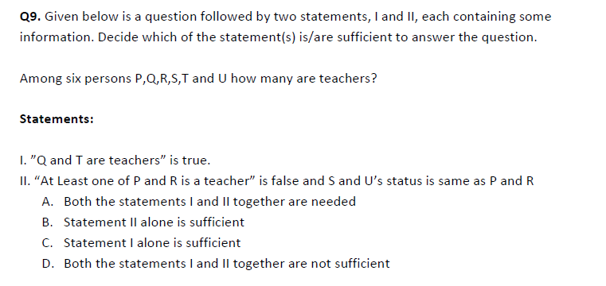

Slide 34
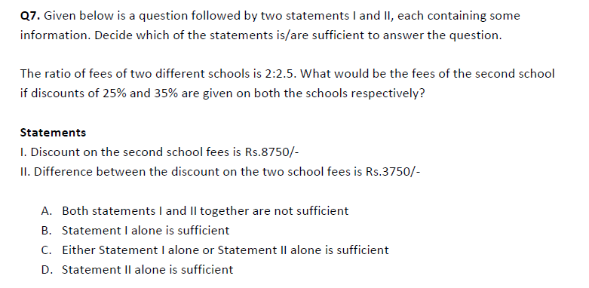

Slide 35
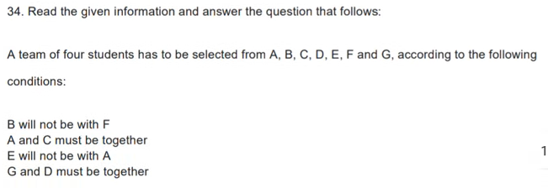
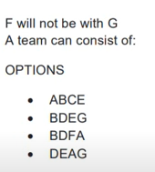

Slide 36
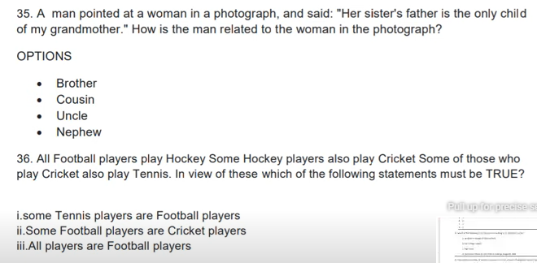

Slide 37
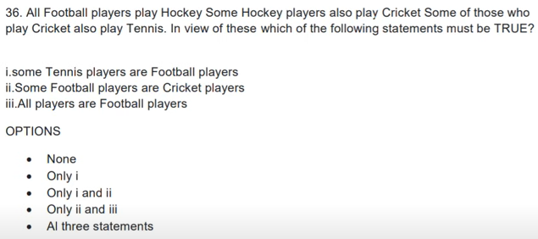

Slide 38
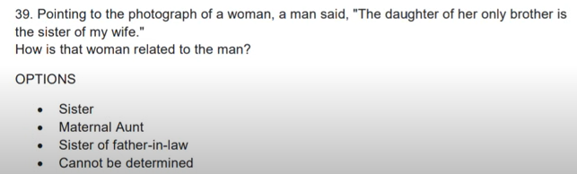

Slide 40
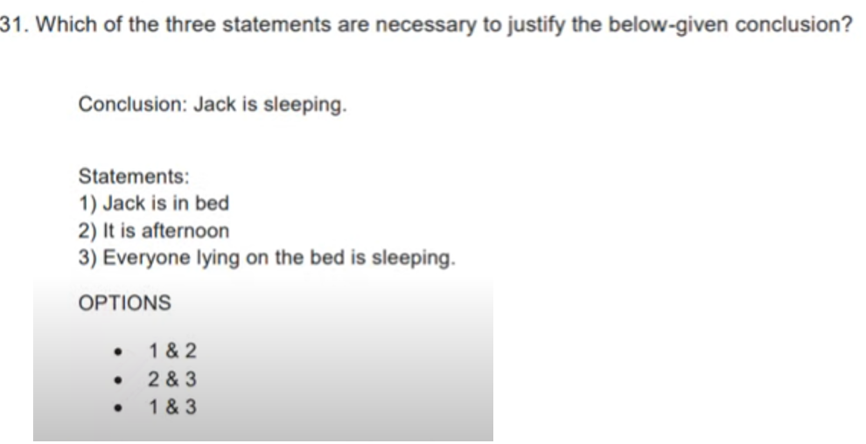

Slide 41
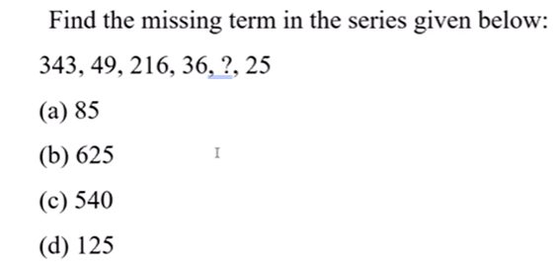

Slide 42
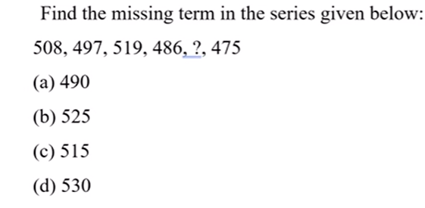

Slide 43
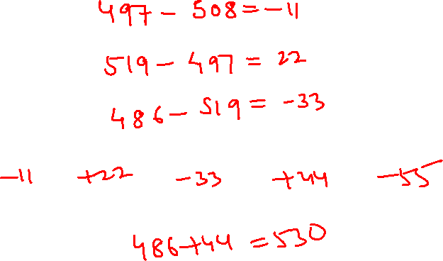

Slide 44
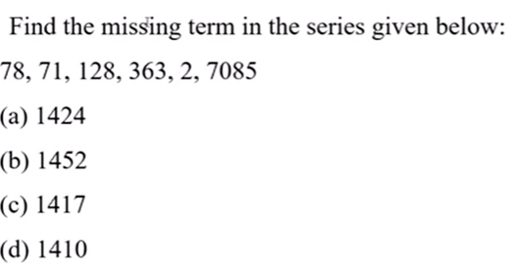

Slide 45
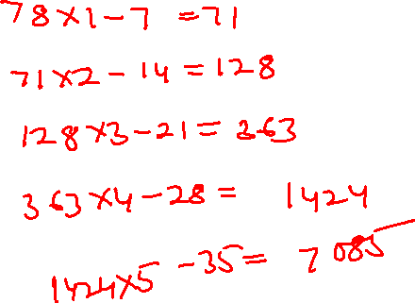

Slide 46
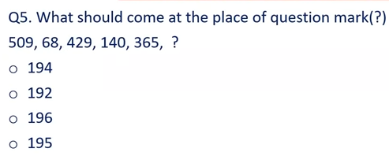

Slide 47
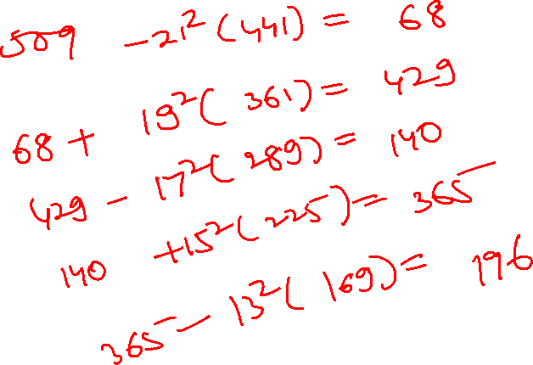

Slide 48
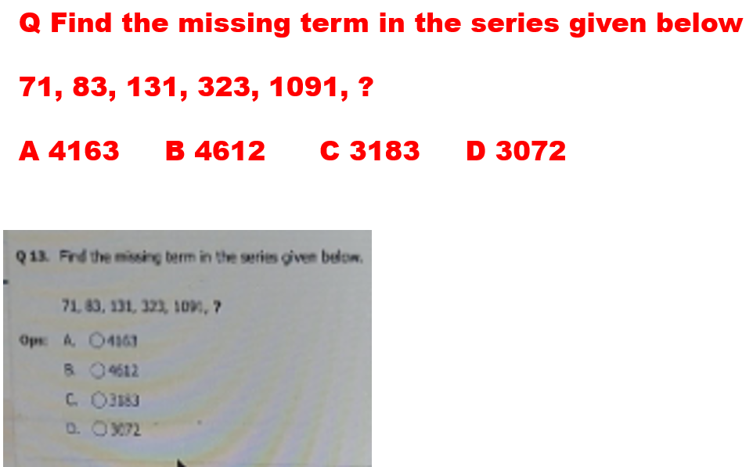

Slide 49
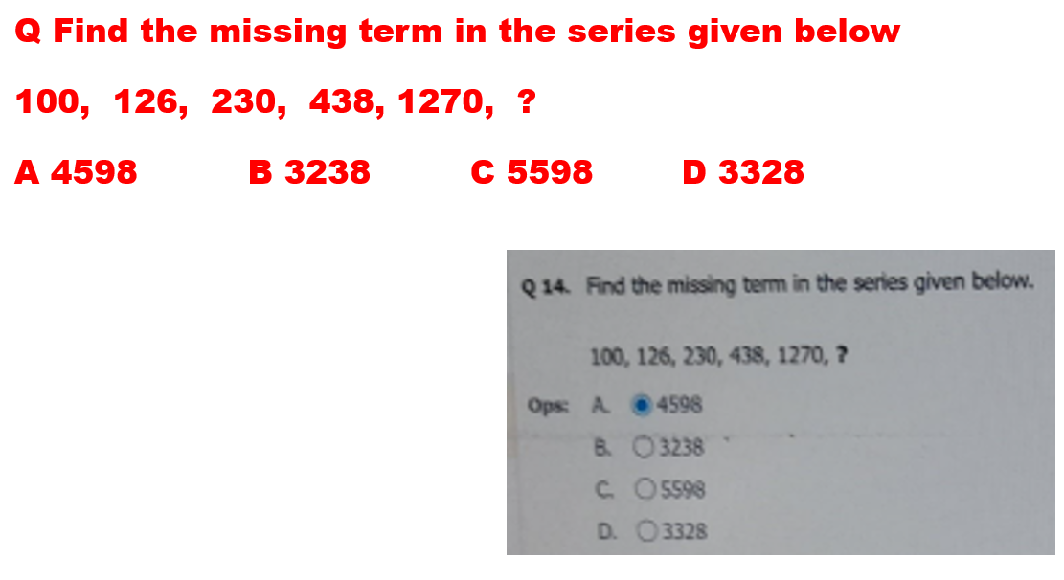

Slide 50
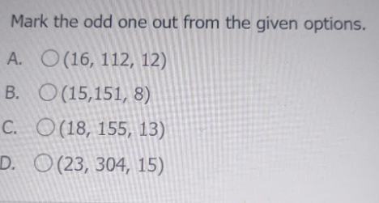

Slide 51
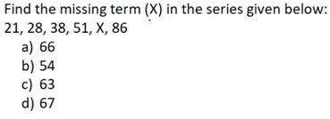

Slide 52
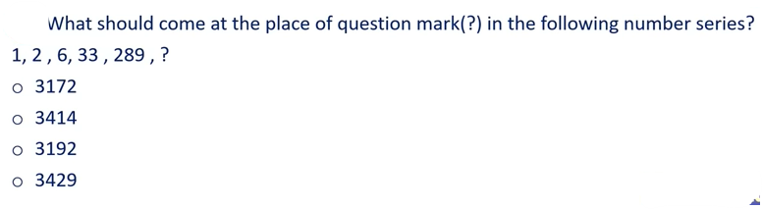

Slide 53
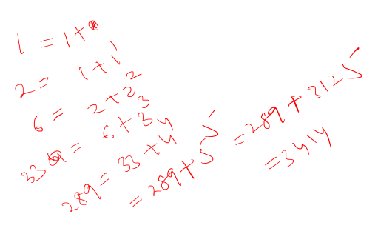

Slide 55
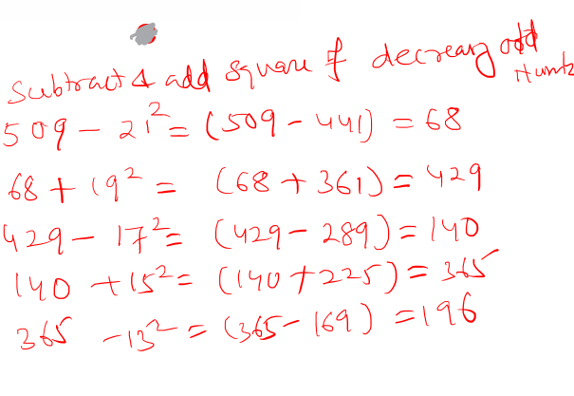

Slide 56


Slide 57


Slide 58


Slide 59


Slide 60


Slide 61


Slide 62


Slide 63


Slide 64


Slide 66


Slide 67


Slide 68


Slide 69


Slide 71


Slide 72


Slide 73


Slide 74


Slide 75


Slide 76


Slide 77


Slide 78


Slide 79


Slide 80


Slide 81


Slide 82


Slide 83


Slide 84


Slide 85


Slide 86


Slide 87


Slide 88


Slide 89


Slide 90



Slide 91


Slide 92


Slide 93


Slide 94


Slide 95


Slide 96


Slide 97


Slide 98


Slide 99


Slide 100


Slide 101


Slide 102


Slide 103


Slide 104


Slide 105


Slide 106


Slide 107


Slide 108


Slide 109


Slide 110


Slide 111


Slide 112


Slide 113


Slide 114


Slide 115


Slide 116


Slide 117


Slide 118


Slide 119


Slide 120


Slide 121


Slide 122


Slide 123


Slide 124


Slide 125


Slide 126


Slide 127


Slide 128


Slide 129


Slide 130


Slide 131


Slide 132


Slide 133


Slide 134


Slide 135


Slide 136


Slide 137


Slide 138


Slide 139


Slide 140


Slide 141


Slide 142


Slide 143


Slide 144


Slide 145


Slide 146


Slide 147


Slide 148


Slide 149


Slide 150


Slide 151


Slide 152


Slide 153


Slide 154


Slide 155


Slide 156


Slide 157


Slide 158
Statement: A line from Ram's appointment letter is "you are hereby appointed as a systems engineer with a probation period of two years and your performance will be reviewed at the end of the period for confirmation."
Assumptions:
I. At the time of appointment, the performance of one generally is not well known.
II. In the probation period, one tries to prove his worth generally. Choose the correct option given below.If only assumption I is implicit
If only assumption II is implicit.
If either I or II is implicit.
If neither I nor II is implicit.
If both I and II are implicit.

Slide 159
Consider the following phrase:
Statement: The price for safeda mango is terribly priced at Rs. 200/kg.
Assumptions: I. The price for other types of mangoes are decently priced.
II. Rs 200 is a very big amount to pay for a safeda mango.
Choose the correct option given below.If only assumption I is implicit
If only assumption II is implicit.
If either I or II is implicit.
If neither I nor II is implicit.
If both I and II are implicit.

Slide 160


Slide 161


Slide 162


Slide 163


Slide 164


Slide 165


Slide 166


Slide 169


Slide 170


Slide 171


Slide 172


Slide 173


Slide 174


Slide 175


Slide 176


Slide 177


Slide 178


Slide 179


Slide 180


Slide 181


Slide 182


Slide 183


Slide 184


Slide 185


Slide 186


Slide 187


Slide 188


Slide 189
How many students are there in the class?
I. There are more than 20 but less than 27 students in the class.
II. There are more than 24 but less than 31 students in the class. the number of students in the class can be divided into groups such that each group contains 5 students.The data in both the Statements I and II together are necessary to answer the question.
The data neither in Statement I nor in Statement II are sufficient to answer the question
The data either in Statement I alone or in Statement II alone are sufficient to answer the question
The data in Statement I alone are sufficient to answer the question, while the data in Statement II alone are not sufficient to answer the question
The data in Statement II alone are sufficient to answer the question, while the data in Statement I alone are not sufficient to answer the question.

Slide 190
Answer: Option A
From statement I, the no of students can be 21,22,23,24,25 or 26. So no certain answer is obtained.
From statement II, the no of students can be either 25 or 30. So again no unique answer is obtained.
On combining the statements, we get 25 as the unique answer.
Therefore, the data in both the Statements I and II together are necessary to answer the question. Hence option A.

Slide 191


Slide 192


Slide 193


Slide 194


Slide 195


Slide 196


Slide 197


Slide 198


Slide 199


Slide 200
In a certain code,
‘very large risk associated’ is written as ‘nu ta ro gi’
‘risk is very low’ is written as ‘ gi se nu mi’
‘is that also associated’ is written as ‘ta mi po fu’
‘inherent risk also damaging’ is written as ‘fu nu di yu’
(All the codes are two letter codes only.)
What does the code ‘di’ stand for?
Either ‘damaging’ or ‘inherent’
Inherent
Also low risk

Slide 201


