Slide 1


Slide 2
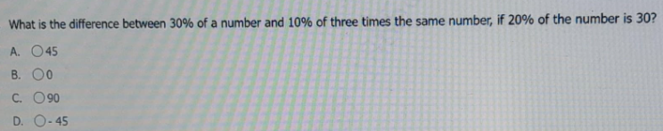

Slide 3
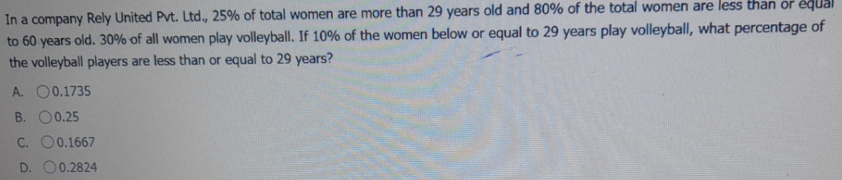

Slide 4
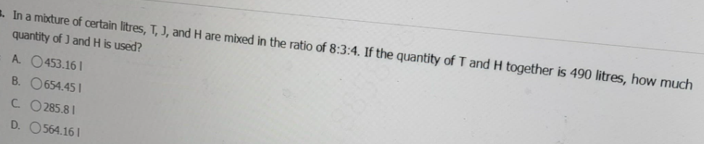

Slide 5
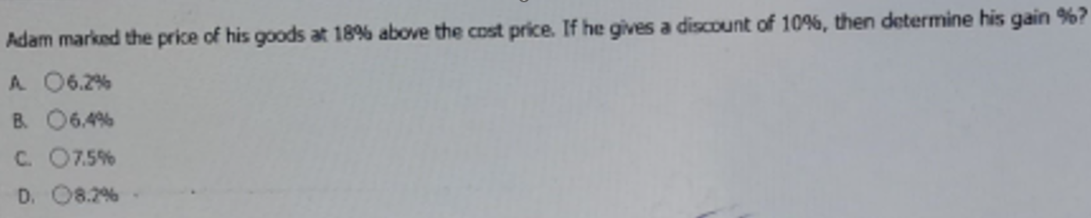

Slide 6
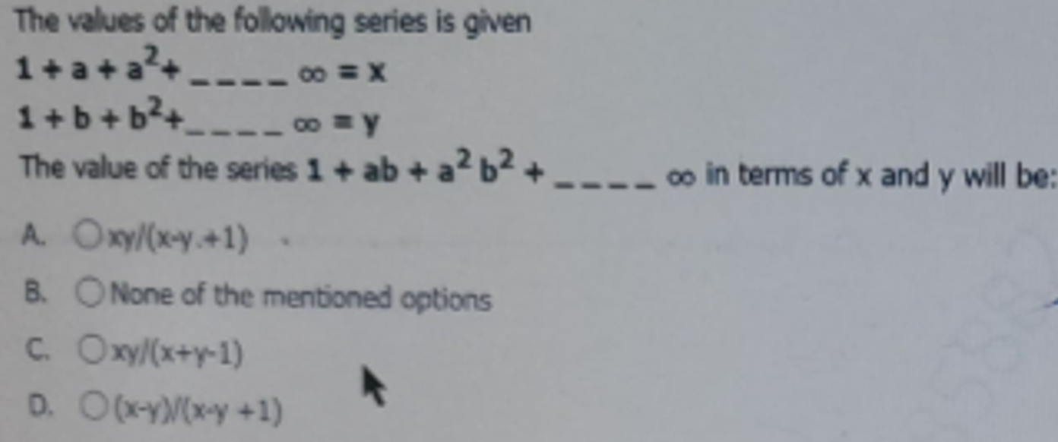

Slide 7
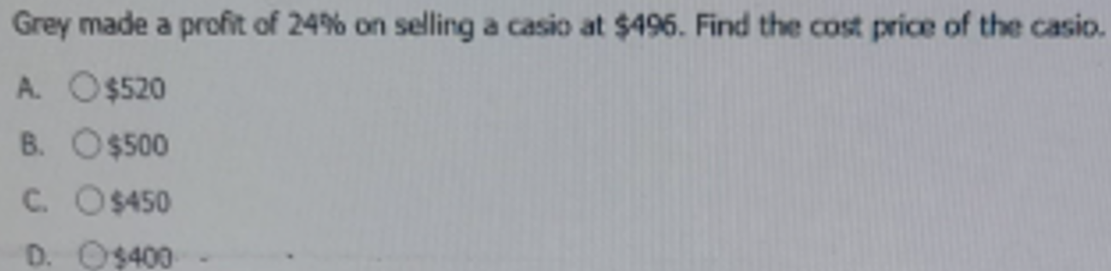

Slide 8
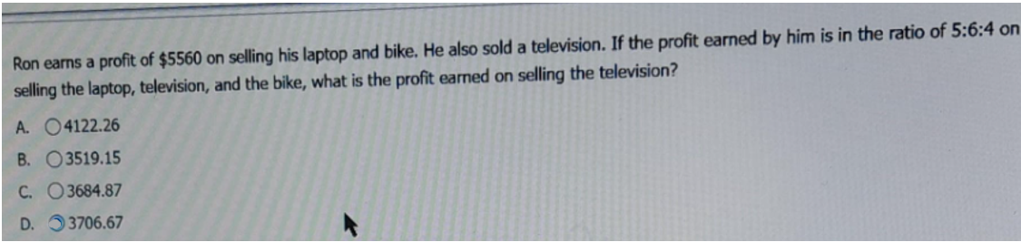

Slide 10
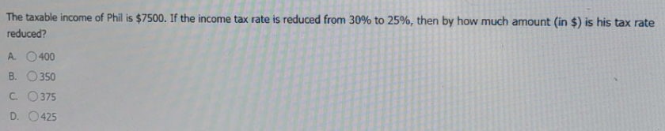

Slide 11
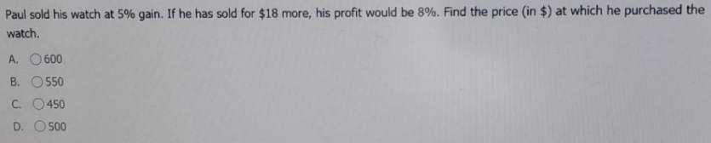

Slide 12


Slide 13
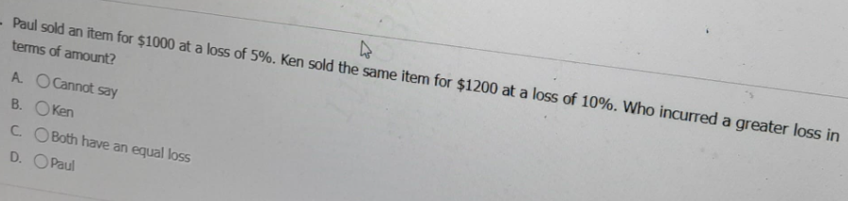

Slide 15
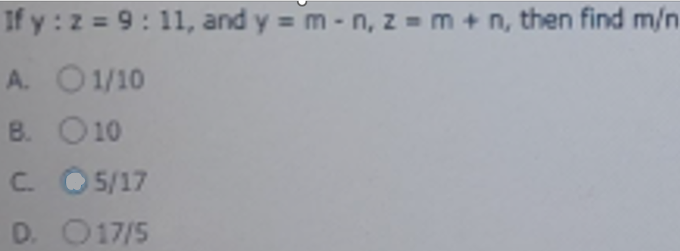

Slide 16
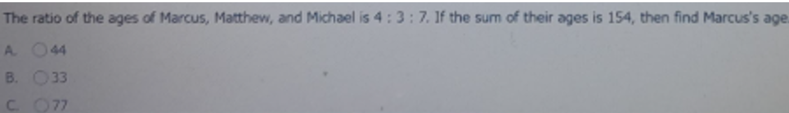

Slide 17
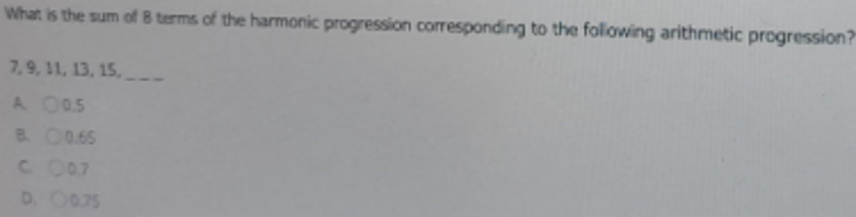

Slide 18
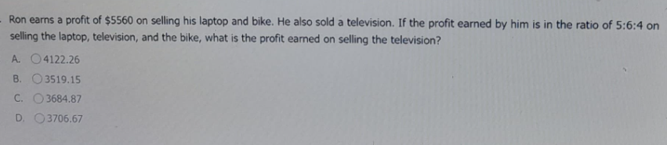

Slide 19
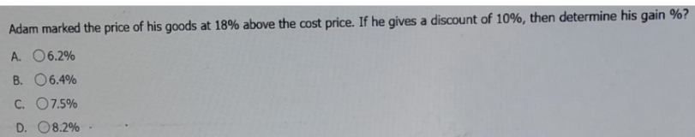

Slide 20
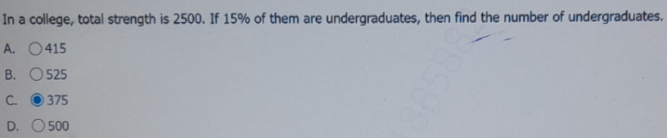

Slide 21
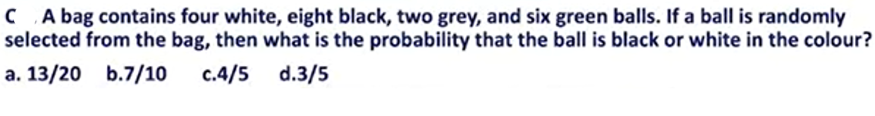

Slide 22
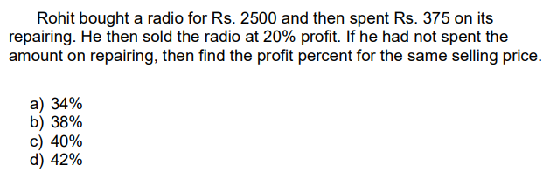

Slide 23
Q Ron earns a profit of $5560 on selling his laptop and bike, he also sold a television. If the profit earned by him is in the ratio of 5:6:4 on selling the laptop, television and the bike , what is the profit earned on selling the television?[HCL]
A 4122.26 B 3519.15 C 3684.87 D 3706.67

Slide 24
Q. In a drawer there are 4 white socks, 3 blue socks and 5 grey socks. Two socks are picked randomly. What is the probability that both the socks are of same colour?
A 4/11 B 1 C 2/33 D 19/66

Slide 25
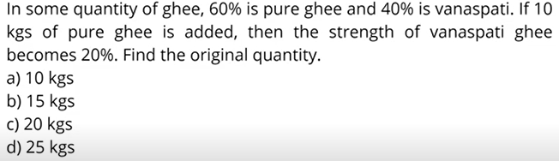

Slide 26
Q. How many three digit numbers can be generated from 1,2,3,4,5,6,7,8,9 such that the digits are in ascending order?
A 80 B 81 C 83 D 84

Slide 27
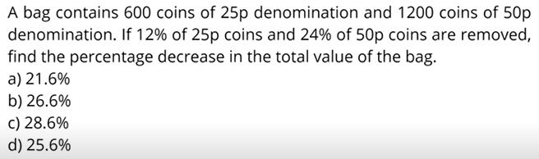

Slide 28
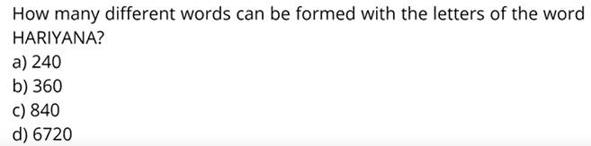

Slide 29
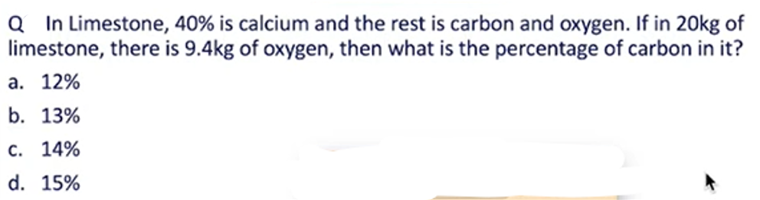

Slide 30
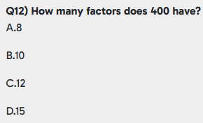

Slide 31
Q.A plane contains 15 points, out of which 6 points lie on a single straight line. Except for the combinations formed among these 6 collinear points, no other combination of 3 points is collinear. How many distinct straight lines can be formed using these points?
(A) 90
(B) 91
(C) 105
(D) None of these

Slide 32
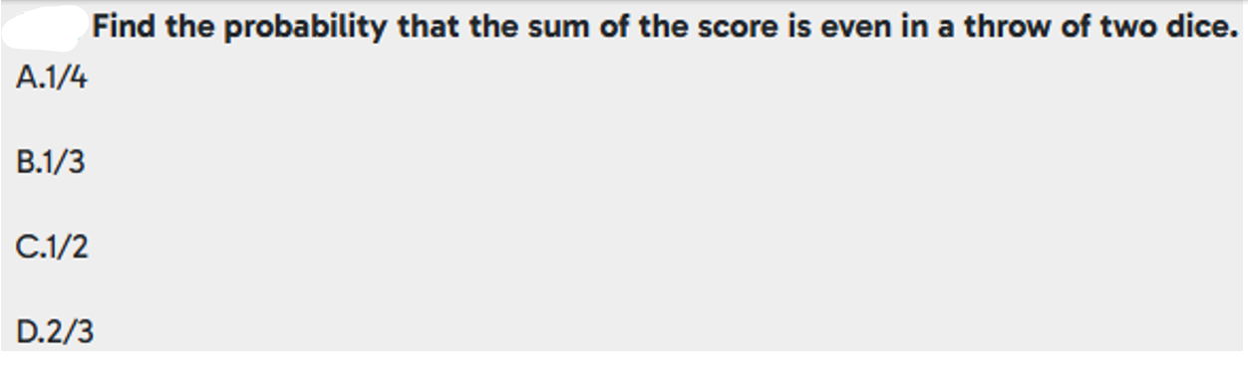

Slide 33
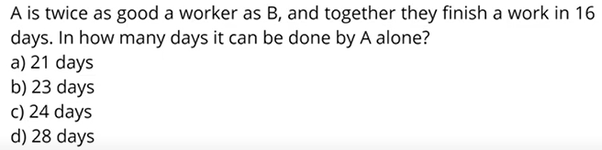

Slide 35
Q. Rs 8400 is divided among A,B,C and D in such a way that the shares of A and B, B and C, C and D are in the ratio 2:3, 4:5 and 6:7 respectively. The share of A is ? [HCL]
A 1280 B 1850 C 1250 D 1275

Slide 36
Q. Carlos invests some amount in a saving bank account that earns an interest of 4% p.a. compounded quarterly . If that amount at the end of 6 months is $ 797718.2,then find the amount invested (in$).[HCL]
A 923000 B 782000 C 620500 D 460000

Slide 37
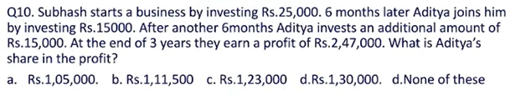

Slide 38
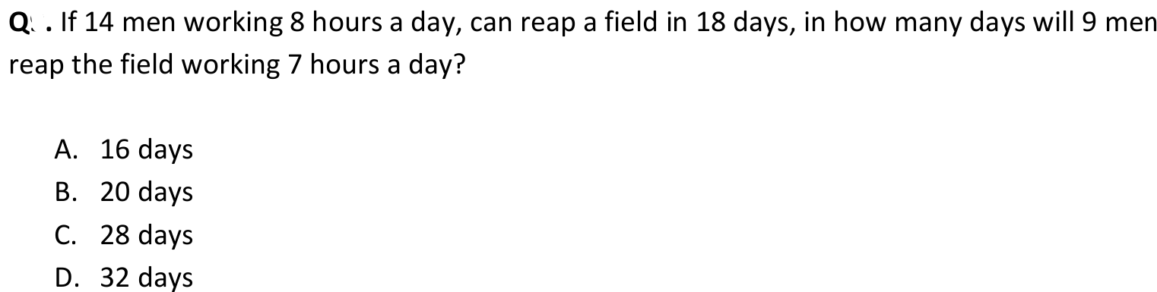

Slide 39
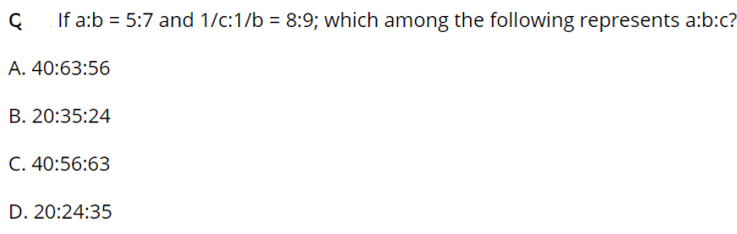

Slide 40
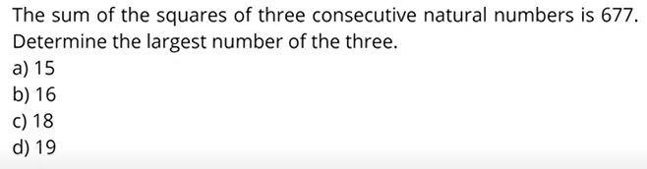

Slide 41
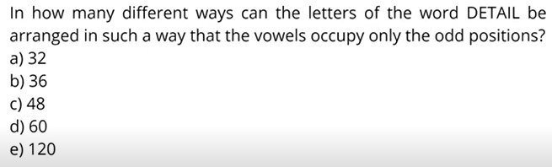

Slide 42
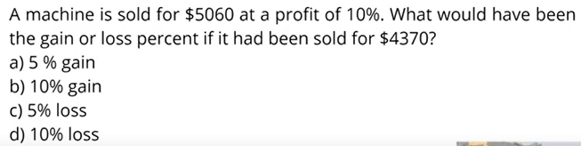

Slide 43
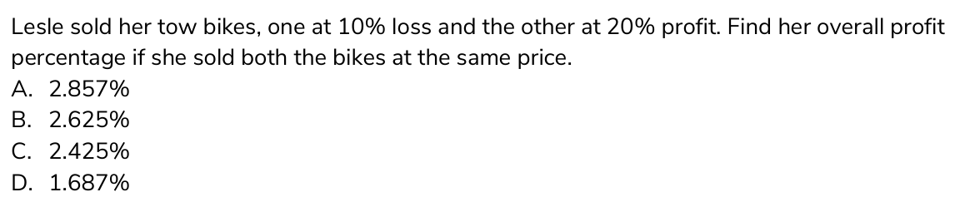

Slide 44
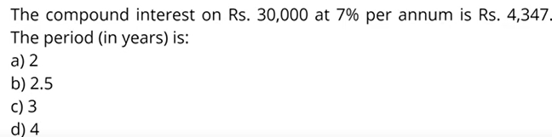

Slide 45
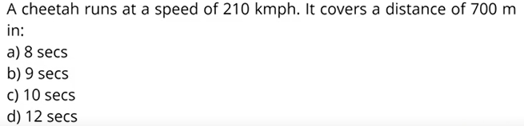

Slide 47
Q The ratio of salaries of peter and paul was 2:3 their salaries were increased by Rs 200 and Rs 600 respectively and the new ratio became 1:2 what were their salaries initially?
A Rs 200,Rs 300
B Rs800,Rs1200
C Rs600,Rs900
D Rs400,Rs600

Slide 48
Q Tim cooper has a certain amount with him and he goes to market he can buy 40 oranges or 28 mangoes he retains 15% of the amount for taxi fares and food he buys 7 mangoes and of the balance he purchases oranges the number of oranges he can purchase is
A 28
B 36
C 24
D 18

Slide 49
Q If 45%of 40% of a number is 900.then find the number
A 6000
B 3000
C 4000
D 5000

Slide 50
Q Jim marked his good 32% above cost price if the marked price of the good were $198 then find the cost price of the good
A $250
B $150
C $180
D $160

Slide 51
Q Matthew sells an article for 120 rs at a loss of 20% at what price should he sell it to gain 10%?
A rs 172.5
B rs178.5
C rs182rs
D 165rs

Slide 52
Q In a class total no of students is 72 which of the following can be ratio of the number of girls and boys in the class
A 3:5
B 7:9
C 8:11
D 10:13

Slide 53
Q If 42%of 4000 =x%of 840 the find the value of x.
A 400
B 200
C 300
D 100

Slide 54
Q The product in a gift shop ar marked 32% above their cost price if the marked price of a greeting card is $211.2 the find its cost price
A $250
B $180
C $150
D $160

Slide 55
Q Matthew sell an article for 120 rs at. a loss of 20% at what price should be sell to gain 10%.
A rs182
B rs178.5
C rs165
D rs172.5

Slide 56
Q. There are three natural numbers the first and second are More than the third by 32%and 36% respectively what percentage of the first number is the second number?
A 106.25%
B 101.56%
C 103.12%
D 103.03%

Slide 57
Q Initially a bike was offered at a discount if 15% as a Result of bargain with the customer the owner reduced his discounted price further by 10% if the selling price of the bike is $7650 the find its marked price?
A $10000
B $8000
C $12000
D $15000

Slide 58
Q The ratio of two numbers A and B is 2:5 and the sum of 6 terms of arithmetic progression starting with A and common difference (B-A) is 285 find the value of B?
A 20
B 30
C 15
D 25

Slide 59
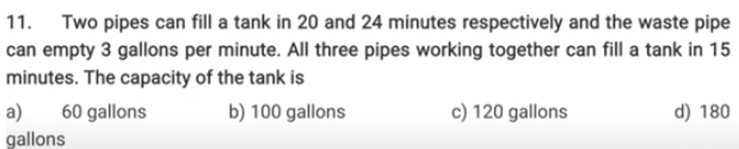

Slide 60
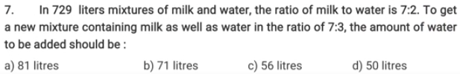

Slide 61


Slide 62


Slide 63


Slide 64
