Slide 1


Slide 2
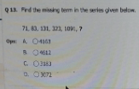
Q Find the missing term in the series given below
71, 83, 131, 323, 1091, ?
A 4163 B 4612 C 3183 D 3072

Slide 3
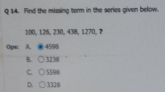
Q Find the missing term in the series given below
100, 126, 230, 438, 1270, ?
A 4598 B 3238 C 5598 D 3328

Slide 4
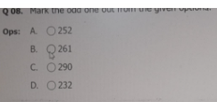

Slide 5
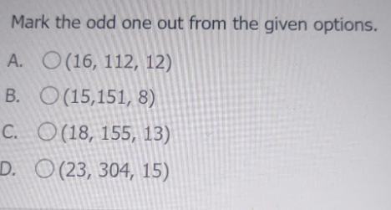

Slide 6
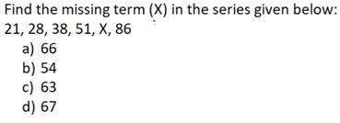

Slide 7
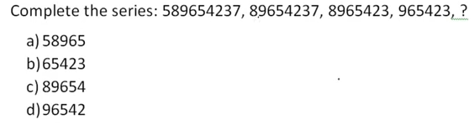

Slide 8
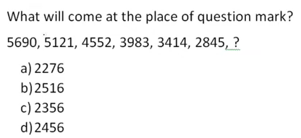

Slide 9
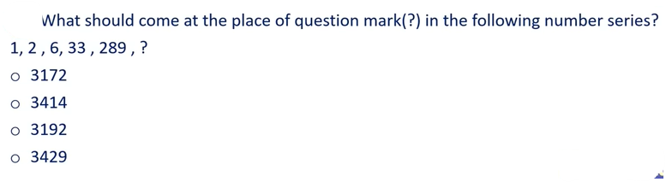

Slide 10
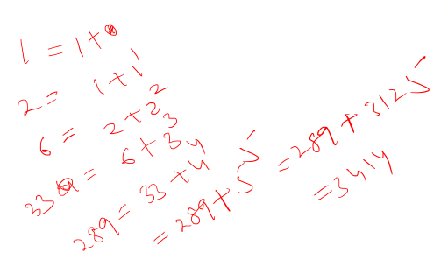

Slide 11
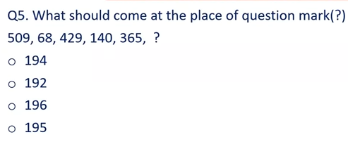

Slide 12
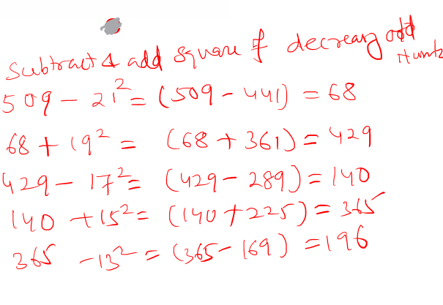

Slide 13
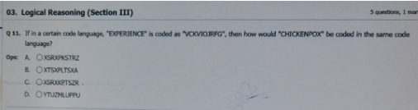
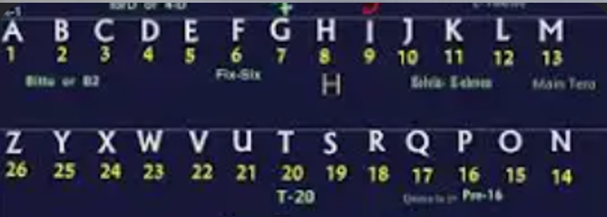

Slide 14
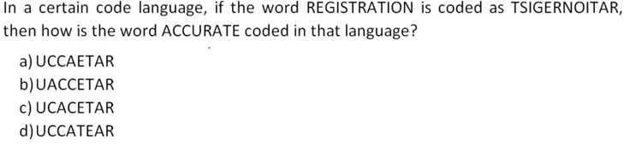

Slide 15
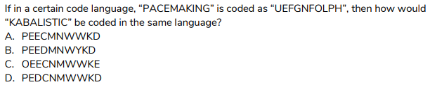

Slide 16
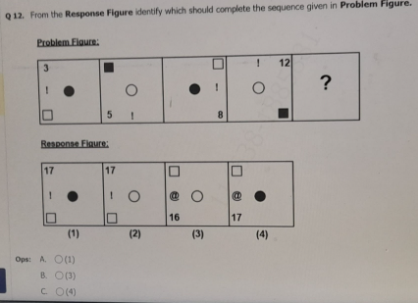

Slide 17
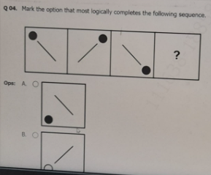

Slide 18
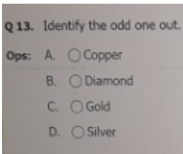

Slide 19
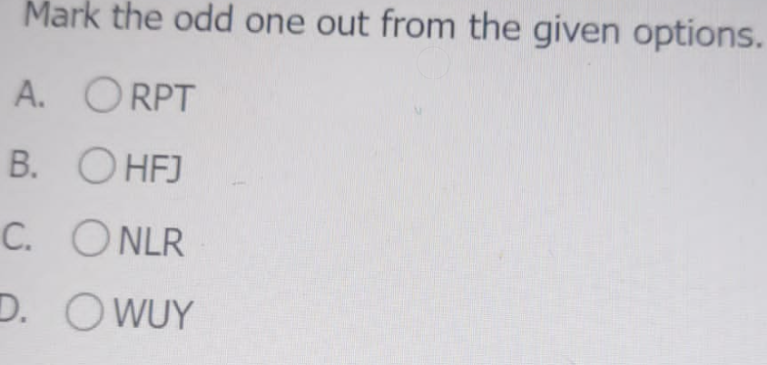

Slide 20
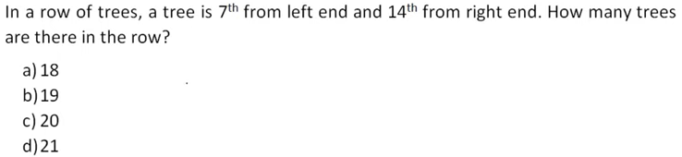

Slide 21
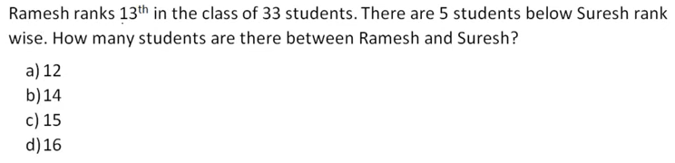

Slide 22
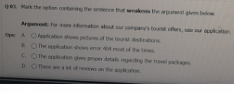

Slide 23
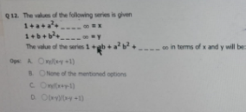

Slide 24
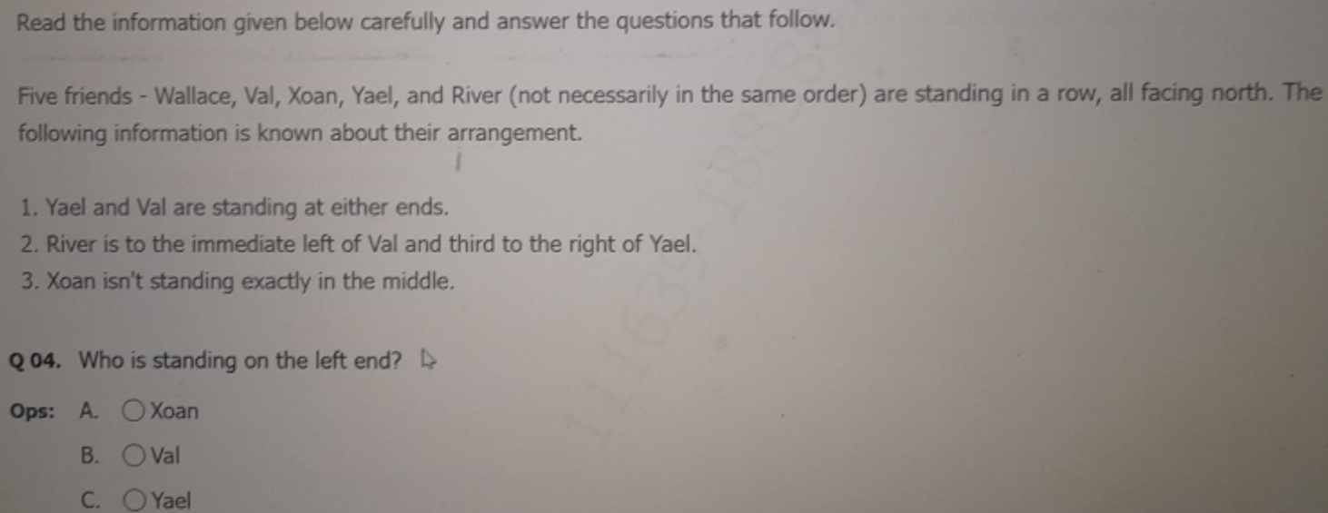

Slide 25
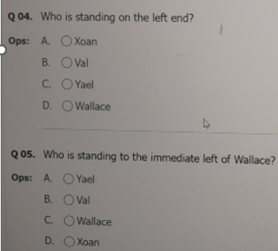

Slide 26
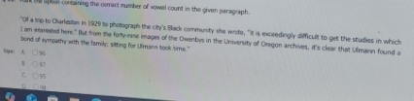
Q “Of a trip to Charleston in 1929 to photograph the city’s Black community, she wrote, it is exceedingly difficult to get the studies in which I am interested here.But from the forty nine images of the Owenbys in the University of Oregon archives, it’s clear that Ulmann found a bond of sympathy with the family, sitting for Ulmann took time.”
A 89 B 96 C 85 D 97 E 94

Slide 27
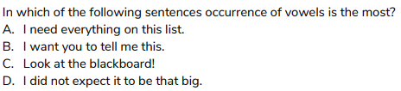

Slide 28
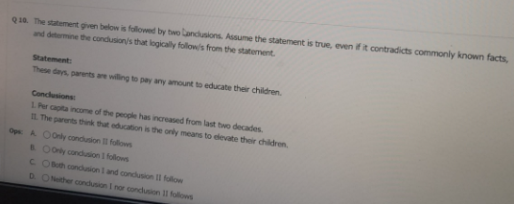
Q. Statement:
These days, parents are willing to pay any amount to educate their children.
Conclusions:
I Per capita income of the people has increased from last two decades.
II The parents think that education is the only means to elevate their children.

Slide 29
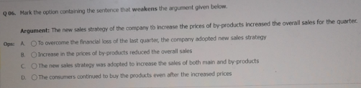
Q Mark the option containing the sentence that weakens the argument given below.
Argument: The new sales strategy of the company to increase the prices of by-products increased the overall sales for the quarter.
A To overcome the financial loss of the last quarter the company adopted new sales strategy.
B Increase in the prices of by products reduced the overall sales.
C The new sales strategy was adopted to increase the sales of the both main and by products
D The consumers continued to buy the products even after the increased prices

Slide 30
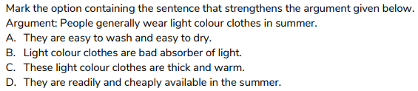

Slide 31
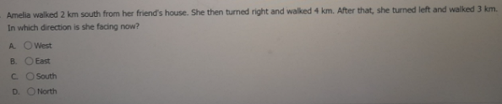
Q Amelia walked 2 km south from her friend’s house. She then turned right and walked 4km.After that, she turned left and walked 3km. In which direction is she facing now?
A West B East C South D North

Slide 32
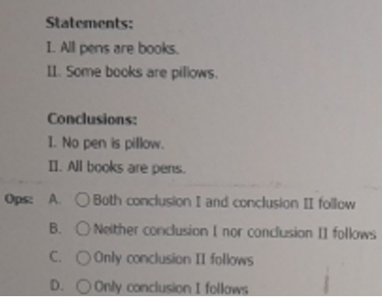

Slide 33
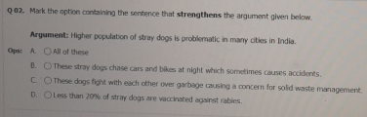

Slide 34
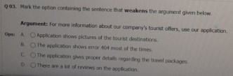

Slide 35
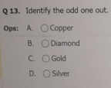

Slide 36
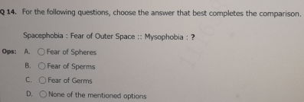

Slide 37
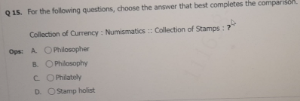

Slide 38


Slide 39
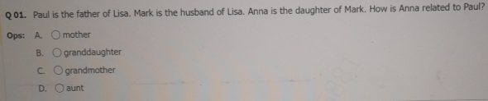

Slide 40
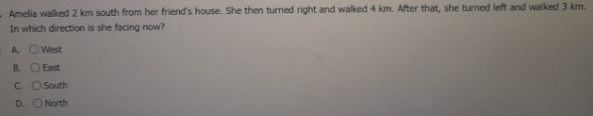

Slide 41
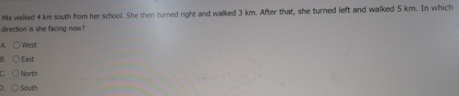

Slide 42
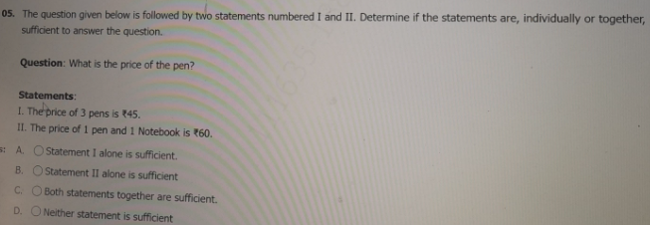

Slide 43
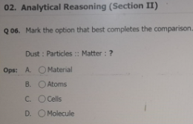

Slide 44
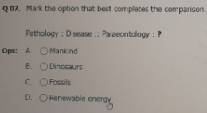

Slide 45
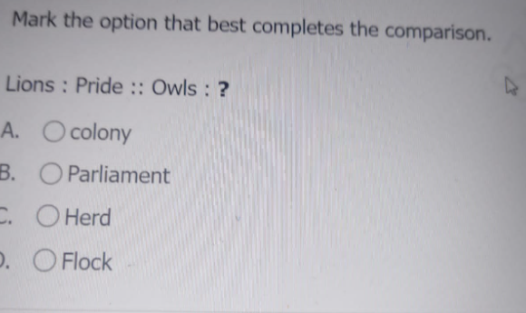

Slide 46
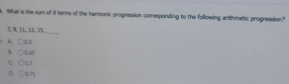

Slide 47
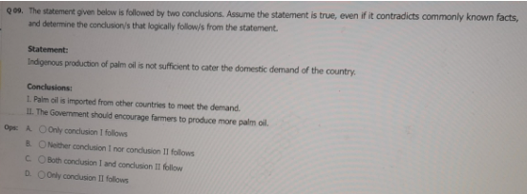
Q The statement given below is followed by two conclusions. Assume the statement is true, even if it contradicts commonly known facts, and determine the conclusions that logically follow/s from the statement.
Statement:
Indigenous production of palm oil is not sufficient to cater the domestic demand of the country.
Conclusions:
I Palm oil is imported from other countries to meet the demand.
II The Government should encourage farmers to produce more palm oil.
A Only conclusion I follows
B Neither conclusion I nor conclusion II follows
C Only conclusion II follows
D Both follows

Slide 48
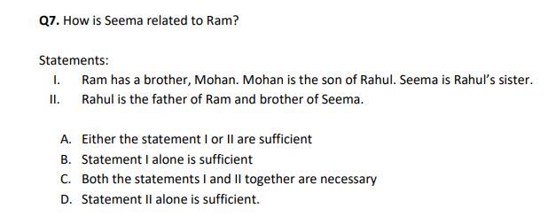

Slide 49
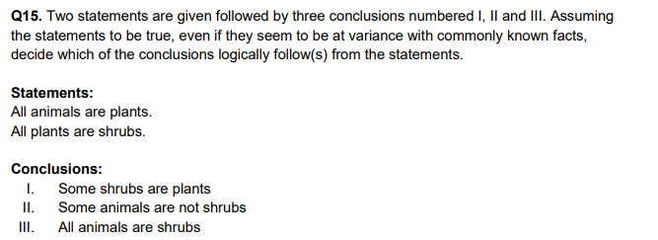

Slide 50
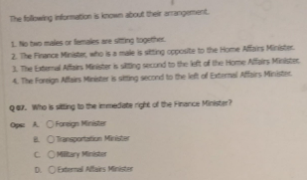

The following information is known about their arrangement.
1. No two males or females are sitting together.
2. The Finance Minister, who is a male is sitting opposite to the Home Affairs Minister
3 The External Affairs Minister is sitting second to the left of the Home Affairs Minister.
4. The Foreign Affairs Minister is sitting second to the left of External Affairs Minister.
Q Who is sitting to the immediate right of the Finance Minister?

Slide 51
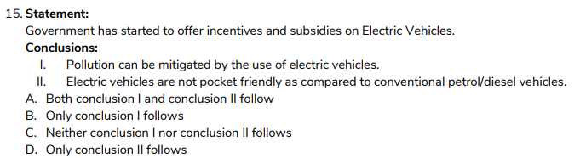

Slide 52


Slide 53


