Slide 1


Slide 2


Slide 3


(UNSUCCESSFUL)
(SUCCESSFUL)

Slide 4

JUST BY HELPING OTHERS

Slide 5

HOW CAN BE USED ?

Slide 6


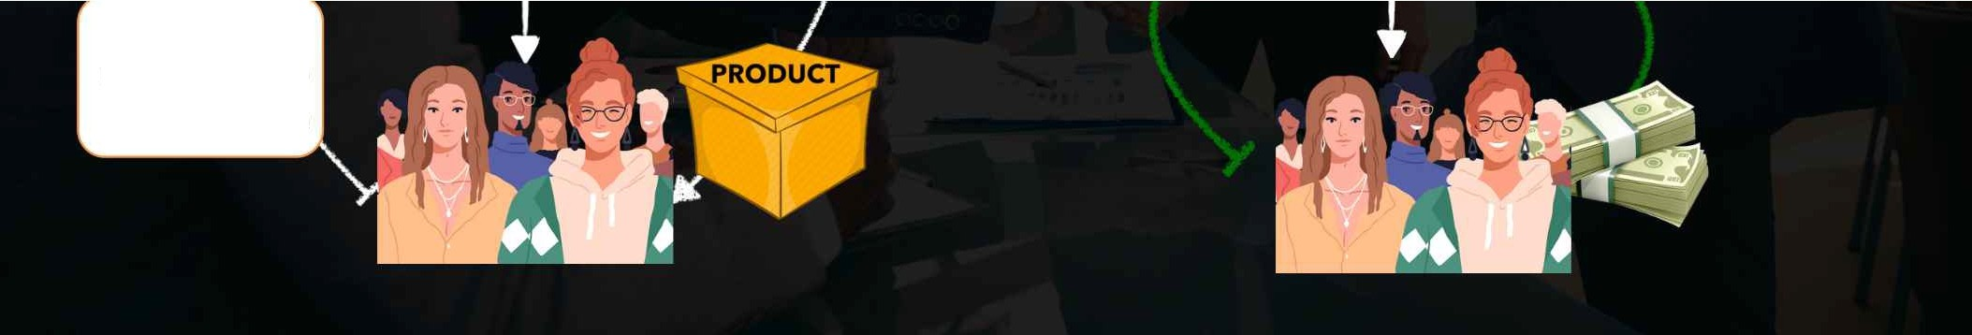
P2P FORUM has
no bank account
Suppose (Joining Fee)
Rs.10,000

Slide 7

No Registration Fee, No Investment
-
No Product Selling, No Chit Fund & Scam
100% Risk Free Pair To Pair Transaction
100% Transparent Platform
Fully Automated Liability Free System
I
lJ)
Instant payment in account

Slide 8

TO BE THE PART OF PENTA P2P FORUM

Slide 9


Slide 10
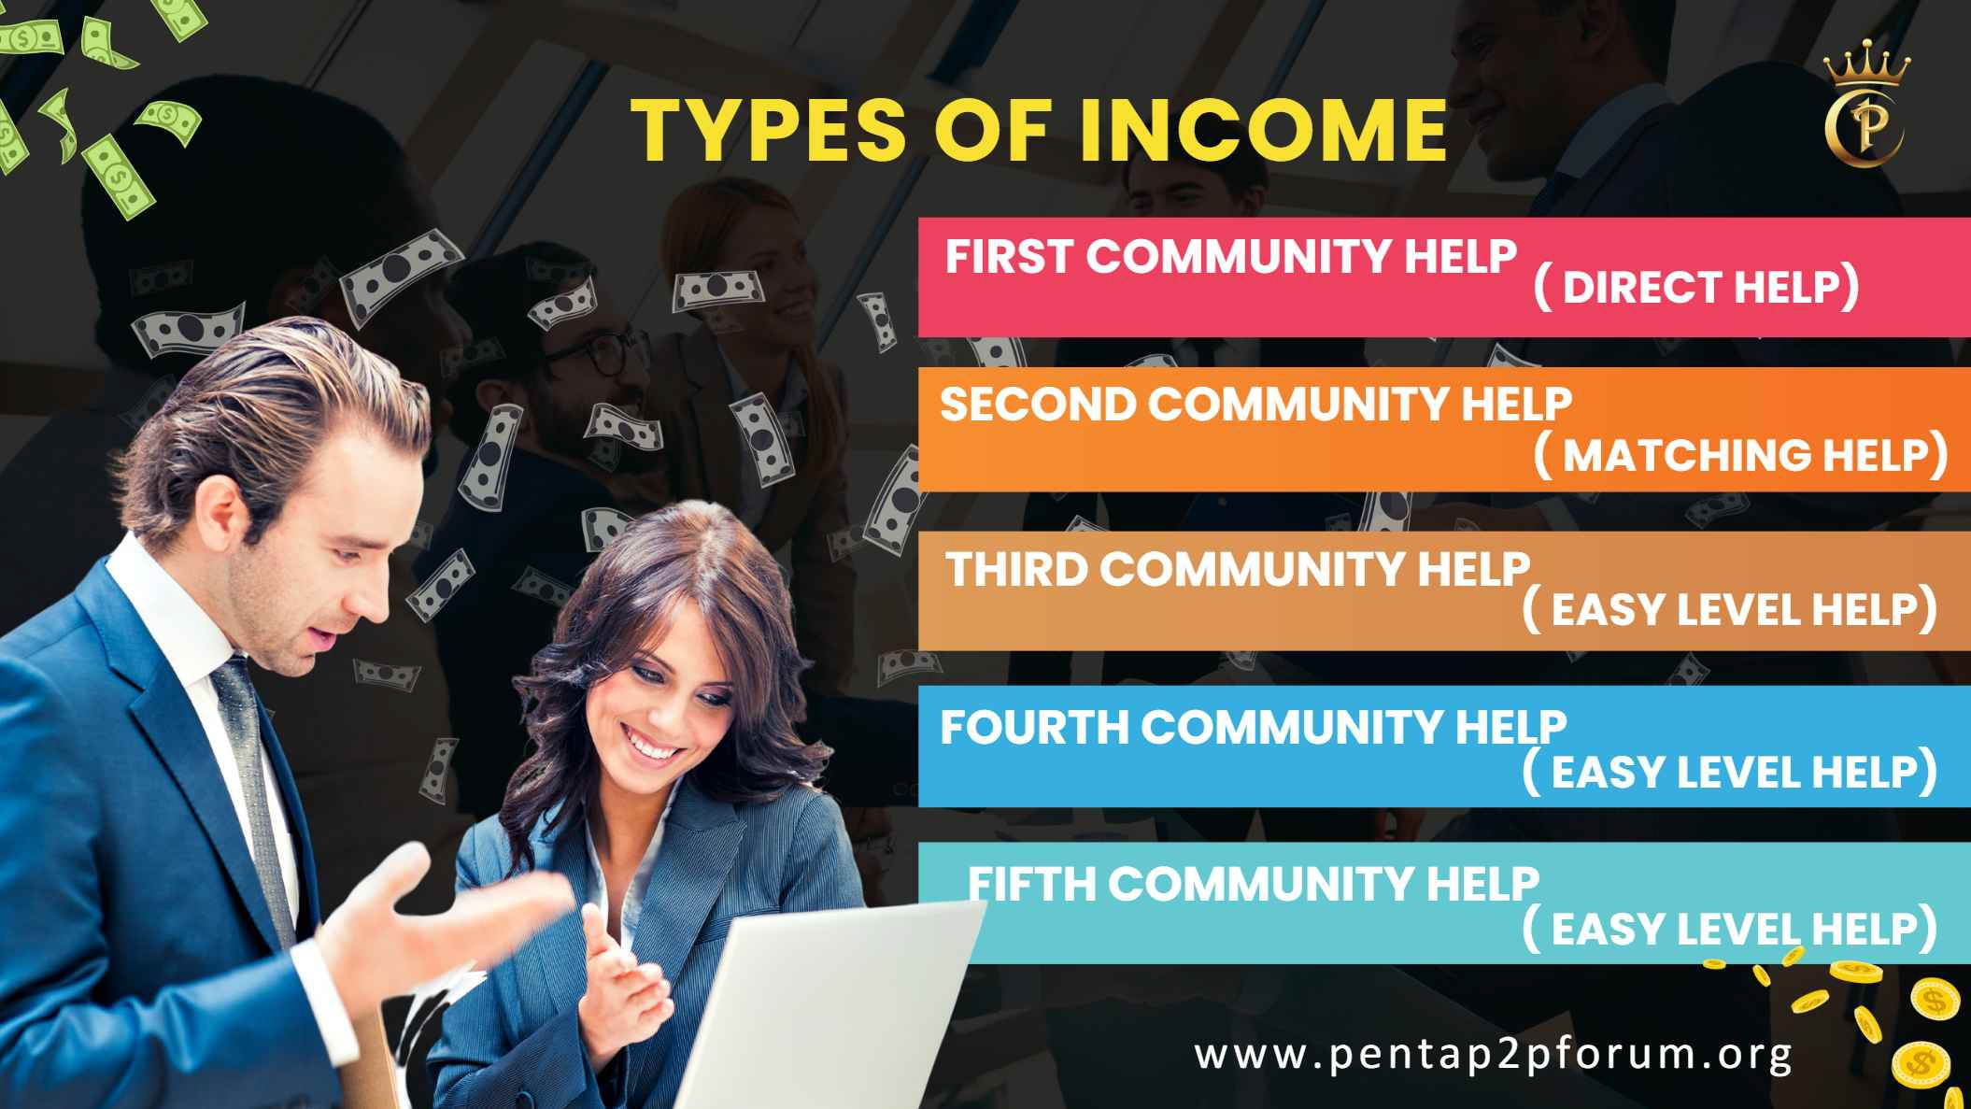

Slide 11
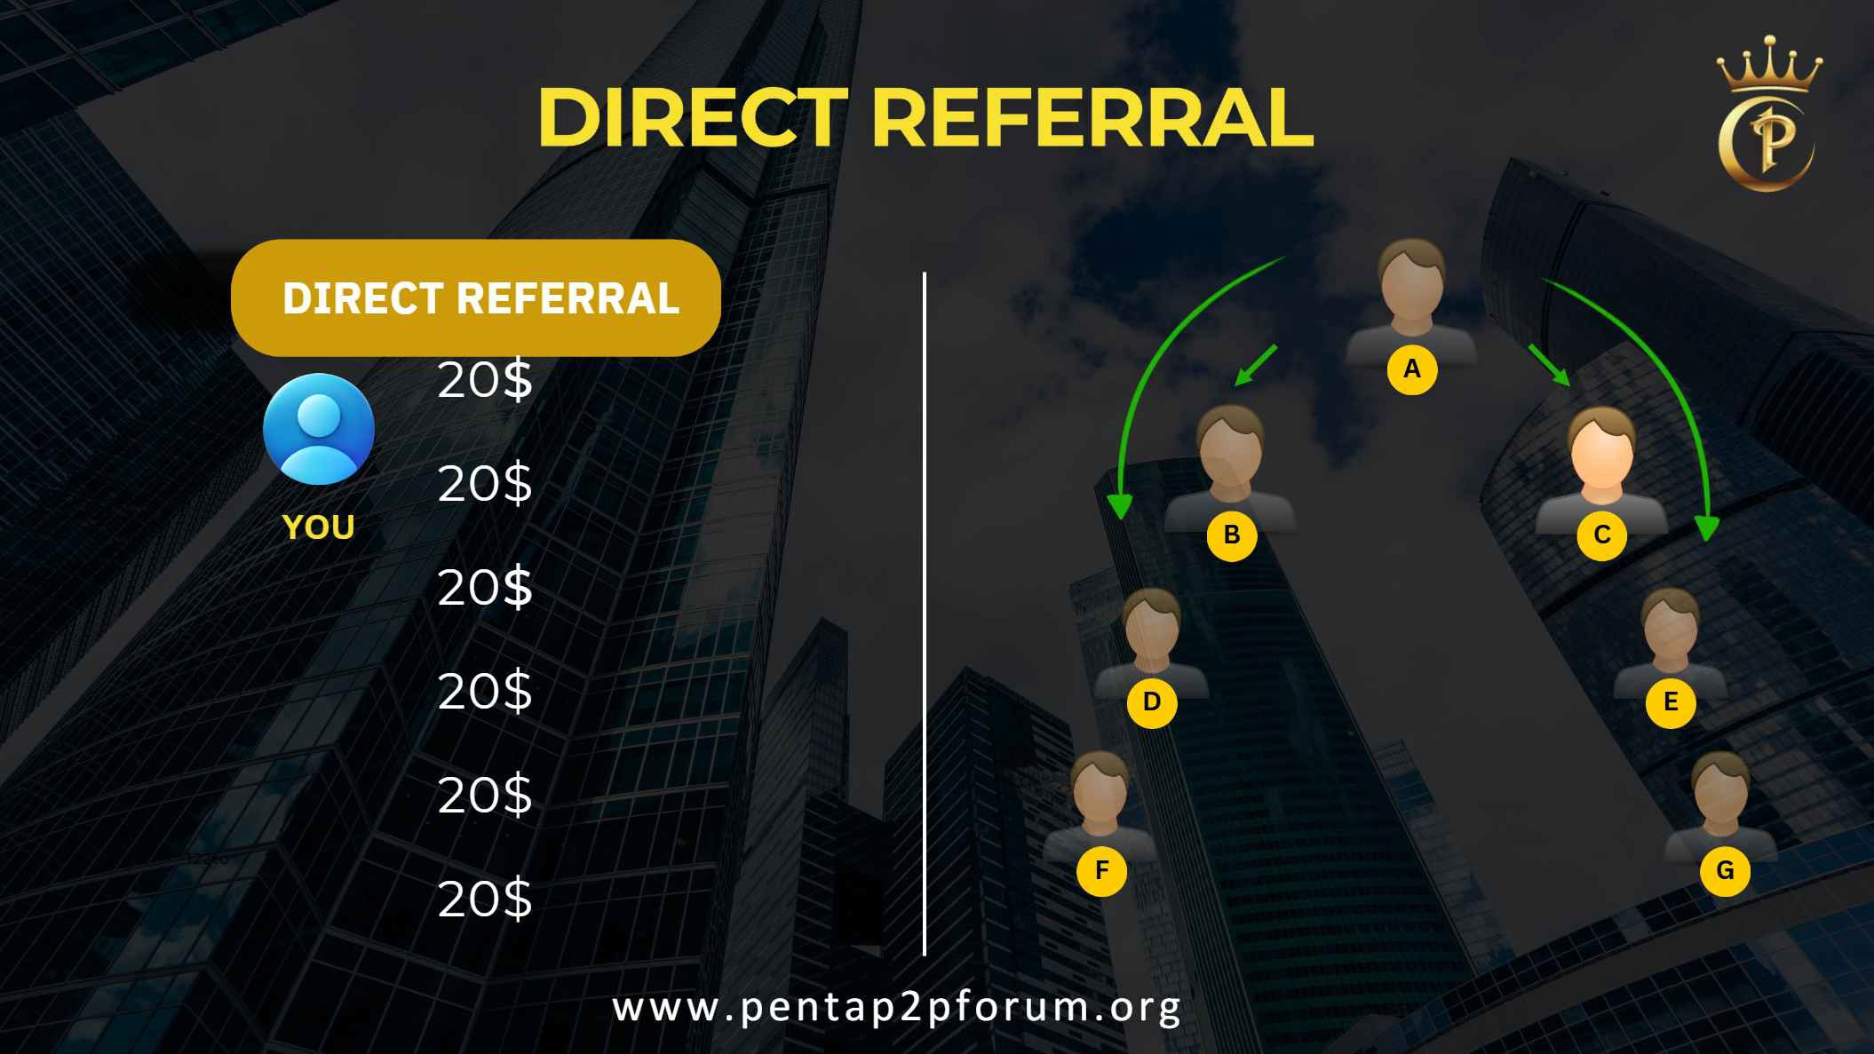

Slide 12


A
B

Slide 13

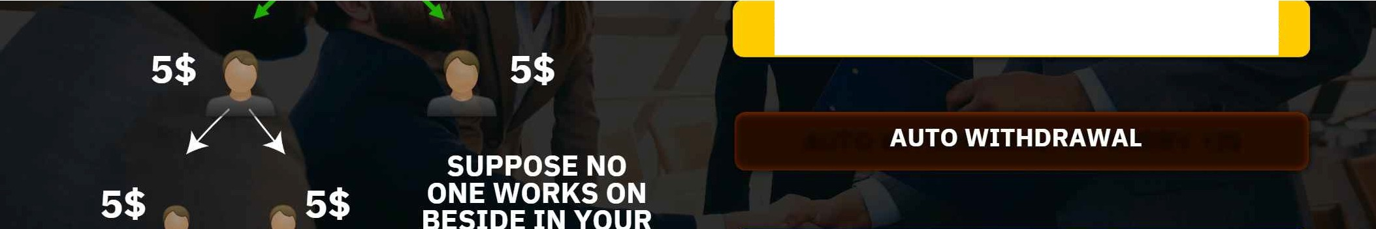
GET 5$ FOR EVERY MEMBER
/"\.
A
DOWNLINE
YOU CAN GET INCOME FROM SINGLE LEG ALSO
5$,
' i _j_
5$
A
A A , \.
.f. ,, .,
.,, .;.
/
.', ,. .,
www. penta p2pfo rum.o rg

Slide 14


 | 25 PAIR
SUPER STAR | 50 PAIR
SILVER | 100 PAIR
GOLD | 250 PAIR
PLATINUM | 500 PAIR
RUBY | 1000 PAIR
SAPPHIRE | 2000 PAIR
PEARL | 5000 PAIR
EMERALD | 10000 PAIR
DIAMOND | 25000 PAIR
D. DIAMOND | 50000 PAIR
CROWN | 1 LAC PAIR
,...
·-- J1
1

Slide 15
WHAT
ARE THE
ADVANTAGES
IN P2P FORUM
OVER
TRADITIONAL BUSINESS?
TRADITIONAL BUSINESS
PENTA P2P BUSINESS
NO HUGE INVESTMENTS
NO RISK AT ALL
SUPPORT SYSTEM
IT'S A TEAM WORK PASSIVE INCOME

Slide 16
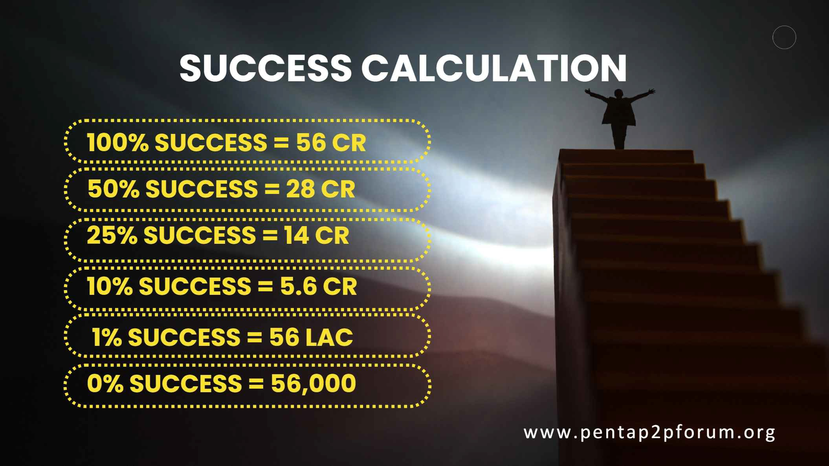

Slide 17


